Slide 1
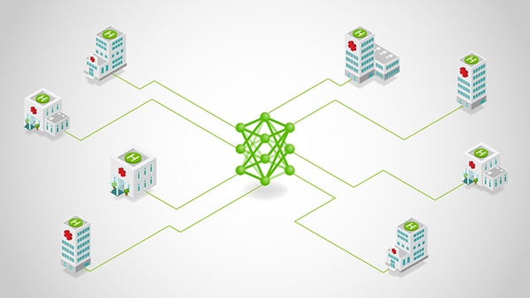
Multi-Task Federated Learning for Personalized Deep Neural Networks
Team -6
Deepti Sinha
Madhura kadaba
prajna k
Sarthak sharma
subin pillai
IISc FACULTY
PROF. CHANDRAMANI SINGH

Slide 2
Muti-Task Federated Learning (MTFL)
Multi-task Federated Learning (MTFL) is an extension of Federated Learning (FL) that focuses on training multiple related models across distributed devices rather than a single global model, without sharing any raw data.
KEY DIFFERENCES:-
Feature | Federated Learning (FL) | Muti-task Federated Learning** (MTFL)
Model type | Single Global Model | Multiple Personalized Models
Data distribution | Assumed similar data across all clients | Handles heterogenous data across clients (non–IID different but related datasets)
Optimization strategy | Federated Averaging (FedAvg) | Muti-task optimization (FedAvg-Adam**)
Accuracy metric | Global model accuracy | User model accuracy (UA **)
Use case | Common tasks across all clients | Personalized learning for all clients
Computation | Takes place centrally on the server | Off-loaded to client devices
https://arxiv.org/pdf/2007.09236 **proposed in this paper by Jed Mills, Jia Hu, Geyong Min

Slide 3
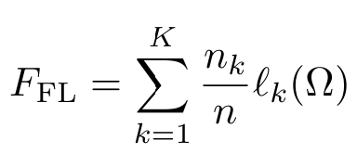
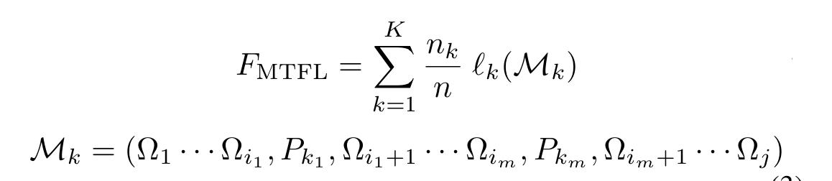
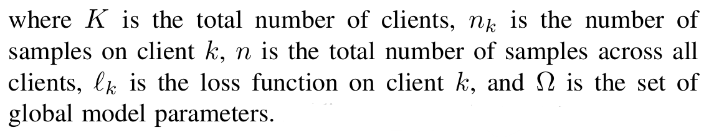
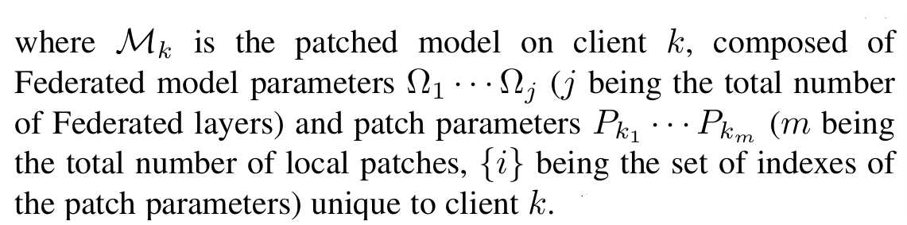
Muti-Task Federated Learning (MTFL)
Feature | Federated Learning (FL) | Muti-task Federated Learning** (MTFL)
Loss function
https://arxiv.org/pdf/2007.09236 **proposed in this paper by Jed Mills, Jia Hu, Geyong Min

Slide 4
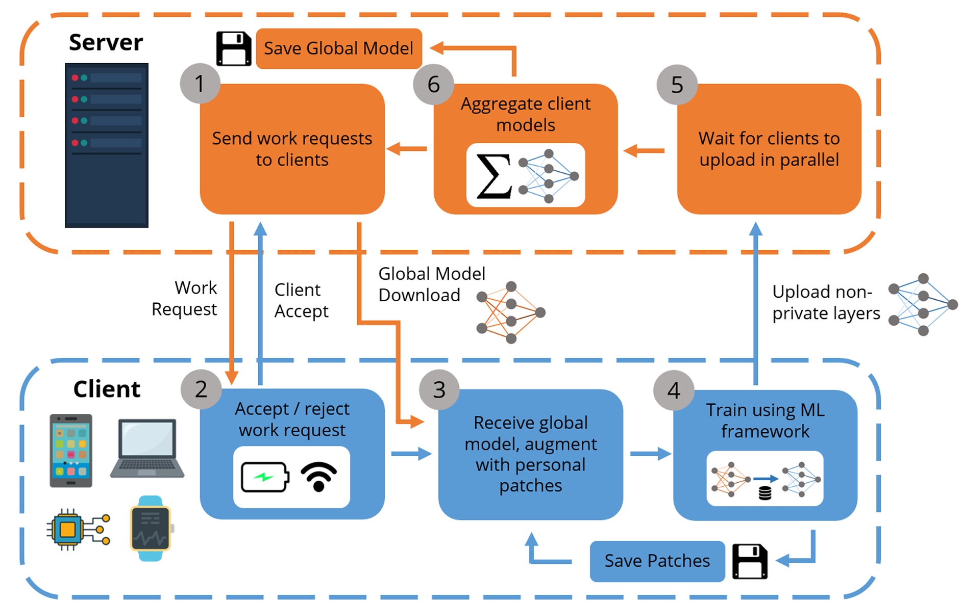
MTFL ALGORITHM
MULTI-TASK FEDERATED LEARNING
Step 1: The server selects a subset of clients from its database to participate in the round, and sends a work request to them.
Step 2: Clients reply with an accept message depending on physical state and local preferences.
Step 3: Clients download the global model (and any optimization parameters) from the server, and update their copy of the global model with private Batch Norm layers as patches.
Step 4: Clients perform local training using their own data, creating a different model. Clients save the private patch layers (BN) locally, and upload their non private model parameters to the server.
Step 5: The server waits for C fraction of clients to upload their non-private model and optimizer values, or until a time limit.
Step 6: The server averages all models, saves the aggregate, and starts a new round.
REFERENCE: https://arxiv.org/pdf/2007.09236

Slide 5
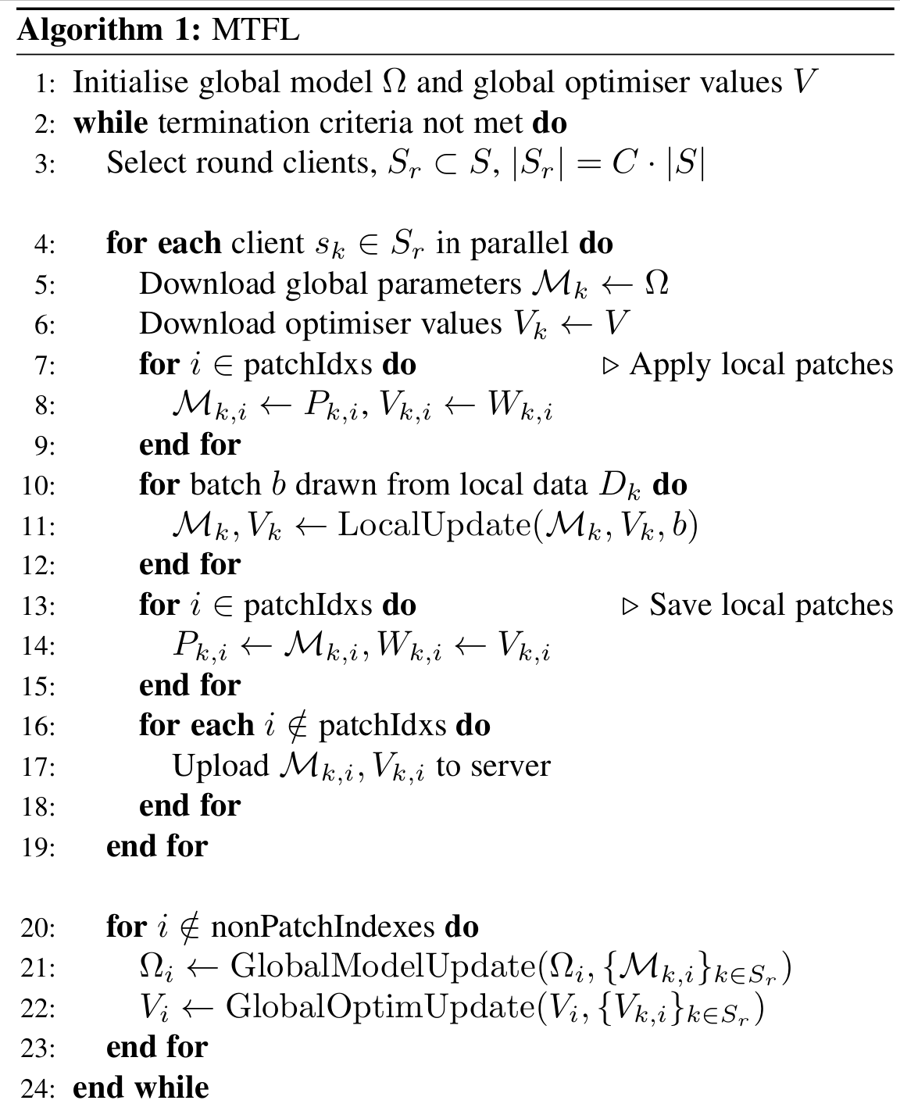

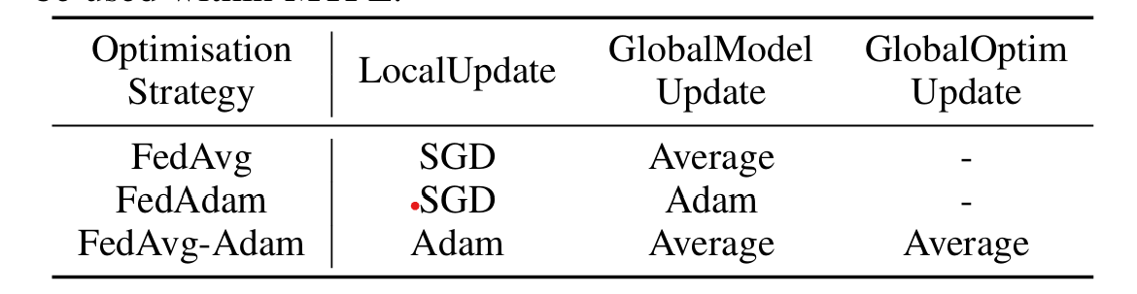
MTFL ALGORITHM
We simulated the federated learning process with Global Sever + Multi-Client setup using the Flower framework.
Each sampled client trained locally on their own data.
METRICS : User model accuracy (UA), Number of communication rounds required to achieve benchmark user model accuracy.
STOPPING CRITERIA : Reach benchmark user model accuracy (UA = 97% for MNIST, UA = 65% for CIFAR10) or run for a fixed number of communication rounds (T).
We compared the performance with custom optimization strategy (FedAvg-Adam) and various existing strategies (FedAvg, FedAdam) with/without private BN params.
patchIdxs contain the indexes of the patch layer placement in the DNN
REFERENCE: https://arxiv.org/pdf/2007.09236

Slide 6
OPTIMIZATION STRATEGIES
FedAvg
FedAdam
FedAvg-Adam
LocalUpdate is minibatch-SGD.
GlobalModelUpdate produces the new global model as a weighted (by number of local samples) average of uploaded client models.
Clients do not use distributed adaptive optimization. (Optimizers V is empty).
GlobalOptimUpdate performs no function.
LocalUpdate is minibatch-SGD.
GlobalModelUpdate, the server takes the difference (∆r) between the previous global model and the average uploaded client model to update the global model using an Adam-like update step.
Clients do not use distributed adaptive optimization. (Optimizers V is empty).
GlobalOptimUpdate performs no function.
All clients share a global set of Adam optimizer values (Optimizers V) received from server.
During LocalUpdate, clients perform Adam SGD, and the federated model layers and new Adam values are uploaded by clients at the end of the round.
To produce a new global model, the server averages the client models in GlobalModelUpdate and averages the Adam moments in GlobalOptimUpdate.
Benefits: Improved convergence speed.
Downside: Increased communication cost per round.

Slide 7


DATASET & FRAMEWORKS USED
Datasets:
 | MNIST | CIFAR10
Data Size | 70,000 labelled images (60k train + 10k test) | 60,000 labelled images (50k train + 10k test)
Image size | 28x28x1 (Gray-scale) | 32x32x3 (RGB image)
Classes | 10 (hand-written digits) | 10 (birds, animals, automobiles)
Transforms | Normalize, Convert to tensor | Normalize, Convert to tensor
Flower
Add some data visualizations here for basic EDA

Slide 8
DATA PRE-PROCESSING
Creating non-IID dataset partitions across clients:
We created a custom function to generate the non-IID partitions, aligned with the strategy described in the paper.
First, we order the training and testing dataset by label and then perform the non-IID split.
Each client has the same classes within their respective training and testing datasets
Number of clients = W
Number of shards = 2xW
Shards per client = 2
Add some data visualizations here for showing class distribution in shards

Slide 9
MODEL DETAILS (DNN with private BN)
28 x28 Grey Scale image (MNIST) serialized as 784x1
32 x32x3 RGB image (CIFAR10)
Conv layer: Input channels: 3, output channels: 32,Filter: 3
Linear Fully-connected layer
(Input dims:784, Output dims: 200)
ReLu activation
Max Pool 2x2
ReLu activation
Batch Normalization layer (dim: 32)
Batch Normalization layer
(dim: 200)
Conv layer: Input channels: 32, output channels: 64,Filter: 3
ReLu activation
Linear Fully-connected layer
(Input dims:200, Output dims: 200)
Max Pool 2x2
Batch Normalization layer (dim: 64)
ReLu activation
Flatten (dim: 6x6x64)
Linear Fully-connected layer
(Input dims:200, Output dims: 10)
Linear Fully-connected layer
(Input dims:2304, Output dims: 512)
10x1 output array
ReLu activation
Linear Fully-connected layer
(Input dims:512, Output dims: 10)
10x1 output array

Slide 10
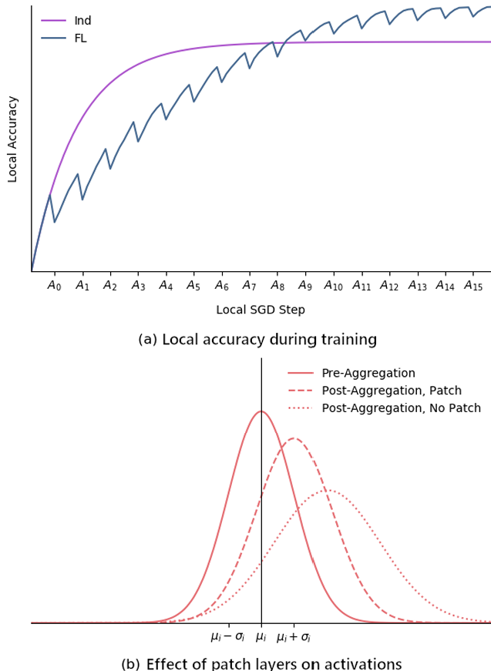
PRIVATE BATCH NORM LAYERS (PATCHES)
During local training, the client’s private Batch Norm layers have been adapted to the local dataset.
If BN-patches are added through out the network, the intermediate DNN values will be regularly ‘constrained’ to be closer to the pre-aggregation values, resulting ultimately in network outputs closer to the pre-aggregation outputs.
When we have a mixture of noisy and non-noisy clients: The harmful effect of receiving a global model that has been harmed by the participation of noisy clients will be reduced since they do not share “all” the model parameters (BN parameters are private and stored locally).
Review this slide

Slide 11
EXPERIMENTS & OBSERVATIONS
Comparing results for Clients = 200, Sampled = 0.5, Dataset = MNIST, Rounds = 300
Strategies = FedAvg, FedAdam, FedAvg-Adam
FL (No private parameters)
MTFL (y,b private BN parameters)

Slide 12
EXPERIMENTS & OBSERVATIONS
Comparing results for Clients = 200, Sampled = 0.5, Dataset = MNIST, Rounds = 300
Strategies = FedAvg, FedAdam, FedAvg-Adam
FL (No private parameters)
MTFL (u, s private BN parameters)

Slide 13
EXPERIMENTS & OBSERVATIONS

Slide 14
EXPERIMENTS & OBSERVATIONS

Slide 15
RESULTS & CONCLUSION

Slide 16
Thank You
Team -6 :
Deepti Sinha, Madhura Kadaba, Prajna k, Sarthak Sharma, Subin Pillai

